Slide 1
Urban FY24 Operating Statistics Report Updates July 16th and 18th, 2024

Slide 2
Webinar Overview
Deadlines
Changes to Report
Report Overview
Live Demo
Preview FY25 Report

Slide 3
OpStats Report Deadlines
Report Deadlines
The reports are due to PTD no later than:
1st Quarter: October 31
2nd Quarter: January 31
3rd Quarter: April 30
4th Quarter/Annual Report: August 31
Please submit a draft report if fiscal year has not been closed out

Slide 4
Changes to FY24 Report
No changes from FY23

Slide 5
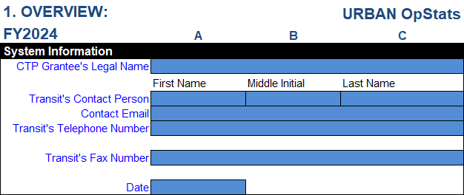
Overview: System Information
Only Enter data into colored cells
Color code for FY 24 is blue

Slide 6
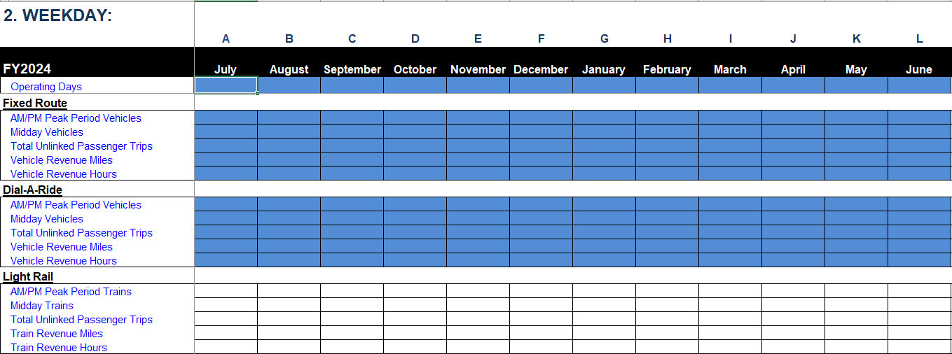
Overview: Operating Modes
Be sure to check the "check box” for your operating modes

Slide 7
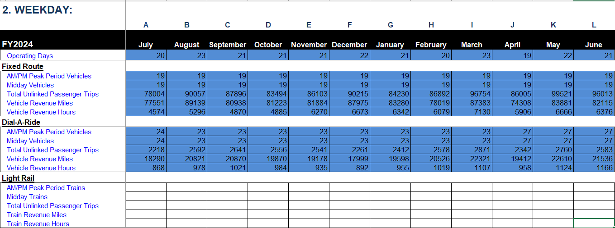
Service Data: Weekday, Saturday & Sunday

Slide 8
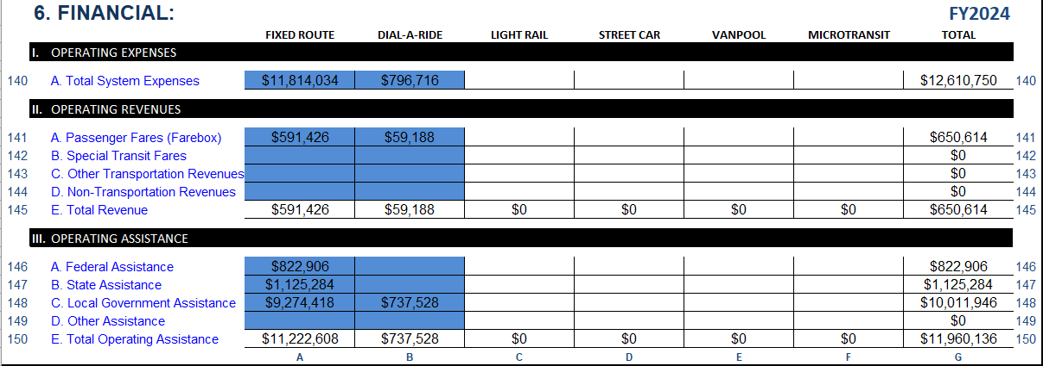
Financial Data

Slide 9
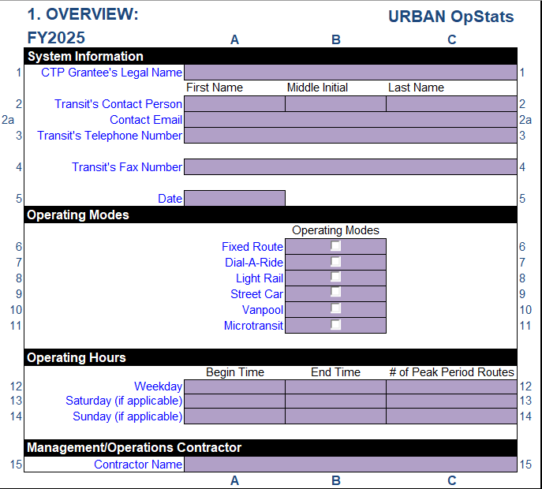
FY25 OpStats Report
FY25, purple color
Report will be available on PTD website
https://connect.ncdot.gov/business/Transit/Pages/Transit-Reports.aspx

Slide 10
Contact
Jeremy Scott
jscott@ncsu.edu
919.515.8624
Jonah Freedman
jfreedman@ncsu.edu
919.515.8622

